Slide 1

Presentation ON
LoRa and IoT based smart irrigation system
Guide:
Dr. Guruprasad B
Assistant Professor ,AIET
Presented by:
4AL19EC001 - A V VEDANTH
4AL19EC008 - ABHISHEK P
4AL19EC027 - DARSHAN S N
4AL19EC037 - JAISON V J

Slide 2
CONTENT
1. Introduction
2. Problem statement and objective
3. Literature review
4. Block diagram
5. Working principle
6. Software description
7. Hardware description
8. Implementation
9. Final project setup
10. Result
11. Conclusion
12. Reference

Slide 3
INTRODUCTION
Water resource one of the most important natural resource problem to be paid more attention in the world in 21st Century.
Irrigation method in traditional agriculture has low utilization of water resource with the development of IoT in this system.
In our project irrigation node sends data to cloud through LoRa gateways via wireless transmission. The system can be controlled manually and remotely by mobile applications.

Slide 4
PROBLEM STATEMENT
Farmers used to turn ON the bore well in order to deliver the water to the agriculture field and later they need to turn OFF the motor after checking the enough availability of water in the agriculture field.
150-200 farmer dies due to snake bite and animal attack every year while they go to turn ON the motor pump during night time.
Wastage of water due to pipeline breakage and over watering.

Slide 5
OBJECTIVE
Design a system that can turn ON and turn OFF the motor manually from home to agricultural field.
Design system where irrigation can be controlled from remote location where internet connection is not available(agriculture field) by using the latest technology like LoRa.
Design system where irrigation can be controlled using voice control(google assistant and alexa).

Slide 6
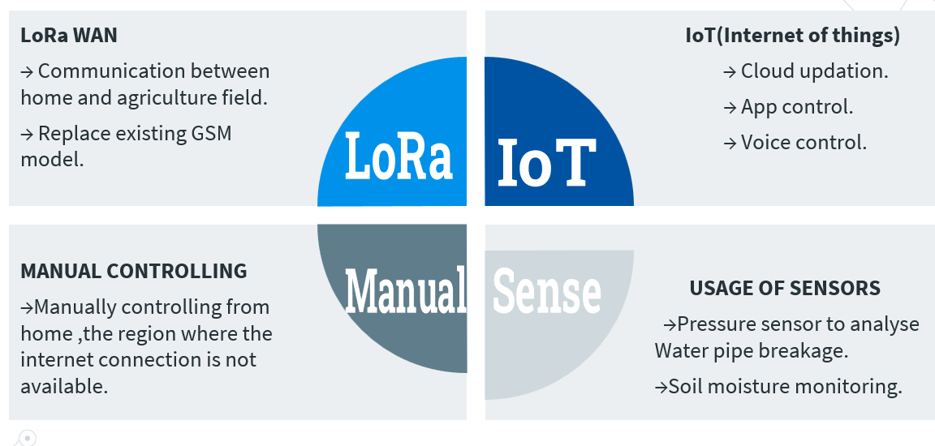
PROPOSED SYSTEM

Slide 7
LITERATURE SURVEY
Daveev [1],This paper shows the useful methods that can be used in smart agriculture system with the help of LoRa technology. The sensor nodes are connected with LoRa modules in order to transfer the sensor data to the processing system, in order to upload it on cloud platform.
C. Bouras [2], Wi-Fi & LoRa as wireless technologies have been compared initially, however the end devices require high power consumption for processing and thus there is requirement of low power network technologies. Experiments carried out on real time basis indicate that LoRa could be an ideal option for building smart rescue monitoring

Slide 8
LITERATURE SURVEY
3. C. S. Gaddam [3], This paper shows the WAN technology i.e. LPWAN is popular and leading technology created for IoT networks. LPWAN is wireless based WAN technology that enables Low power consumption, long range, lower bandwidth with low bit rates.
4. A. Lavric [4], Long-range transfer of information is enabled by LoRa modules, with a low transfer rate. Considering the requirements this paper presents the evaluation of the LoRa technology in the field of IoT and Architecture requirements of LoRa WAN communication protocol have been discussed along with the evaluation of LoRa modulation performance.

Slide 9
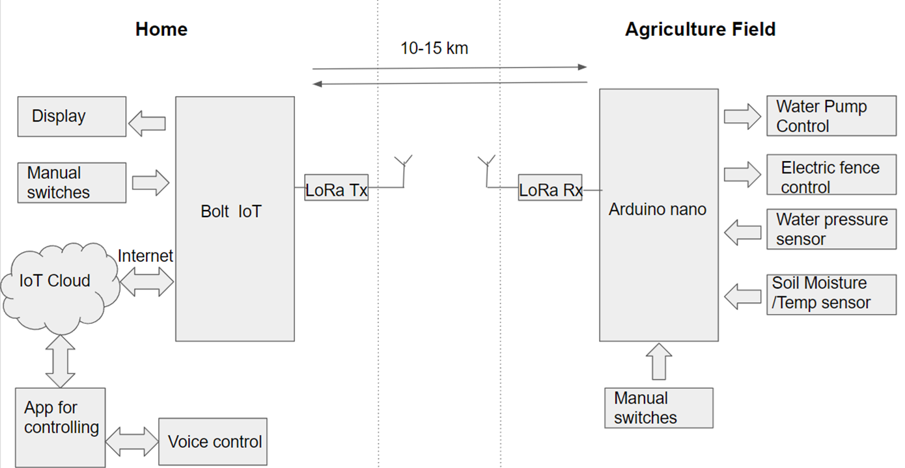
BLOCK DIAGRAM

Slide 10
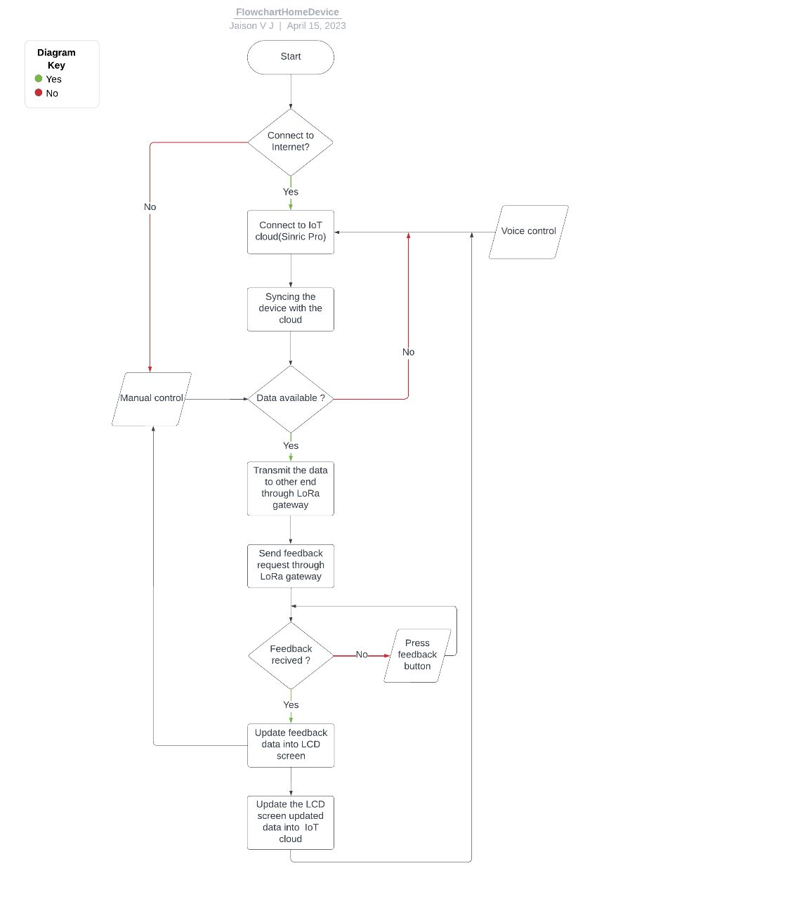
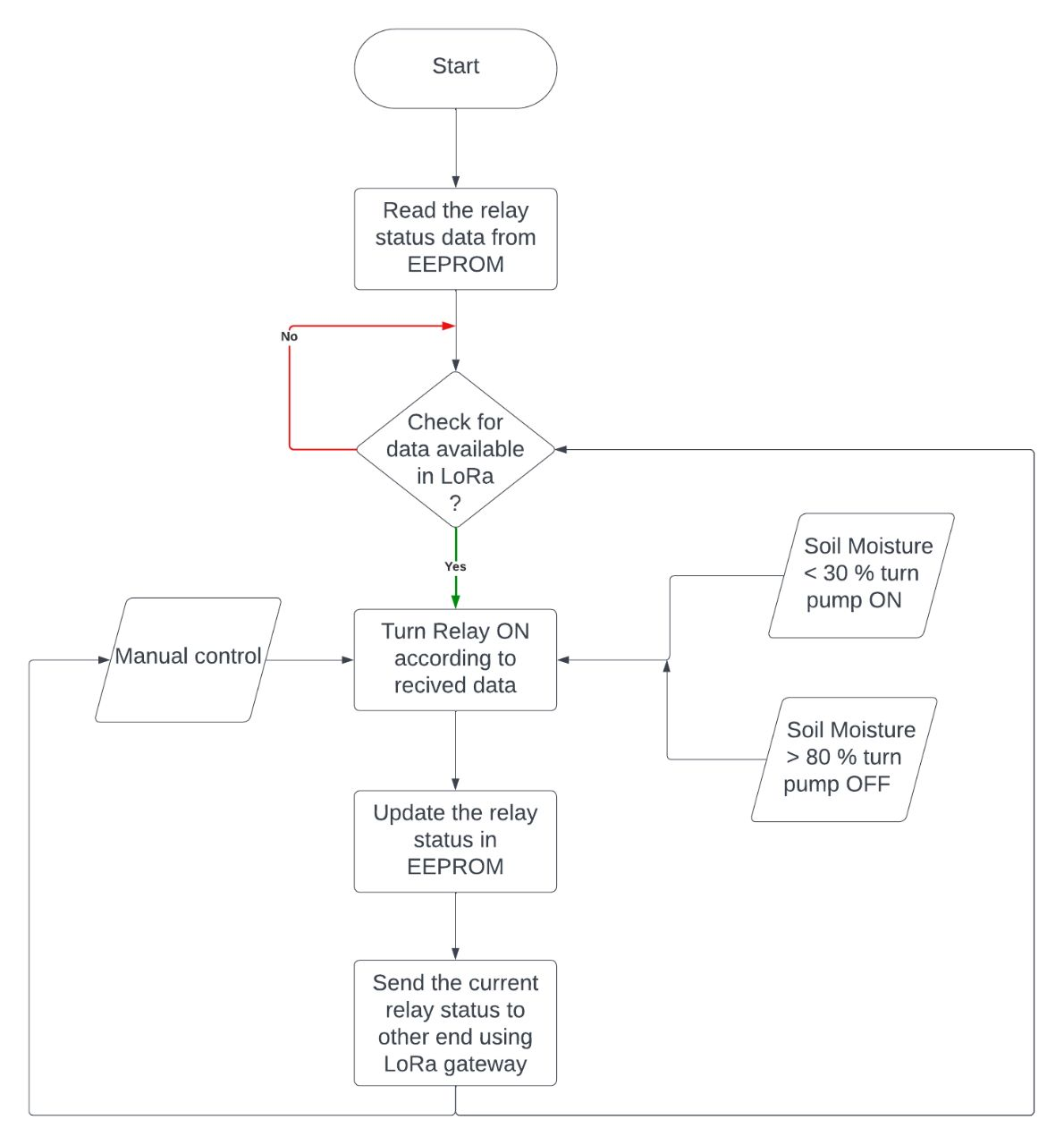
WORKING PRINCIPLE

Slide 11
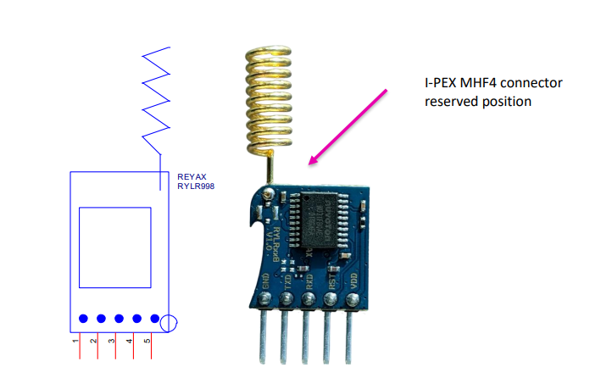
UNIQUE FEATURES OF LORA
The frequency band for LoRa Technology in India is 865 MHz to 867 MHz.
Input Voltage of 3.3V(Min 1.8V and Max 3.6V).
Communication range of 10 KM .
IEEE Standard of 802.15.4
Semtech LoRa Engine.
Excellent blocking immunity.
Smart receiving power saving mode.
High sensitivity.
Control easily by AT commands.
Built-in antenna.
Command support data encryption .

Slide 12
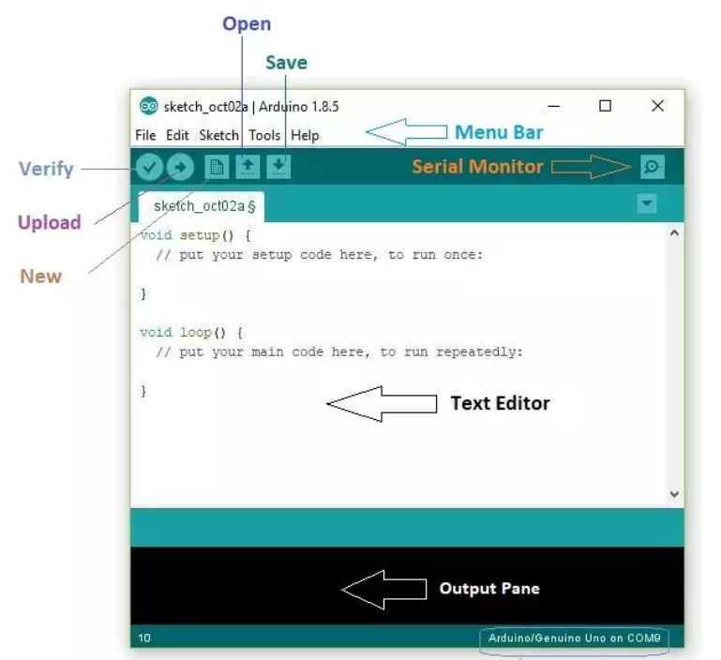
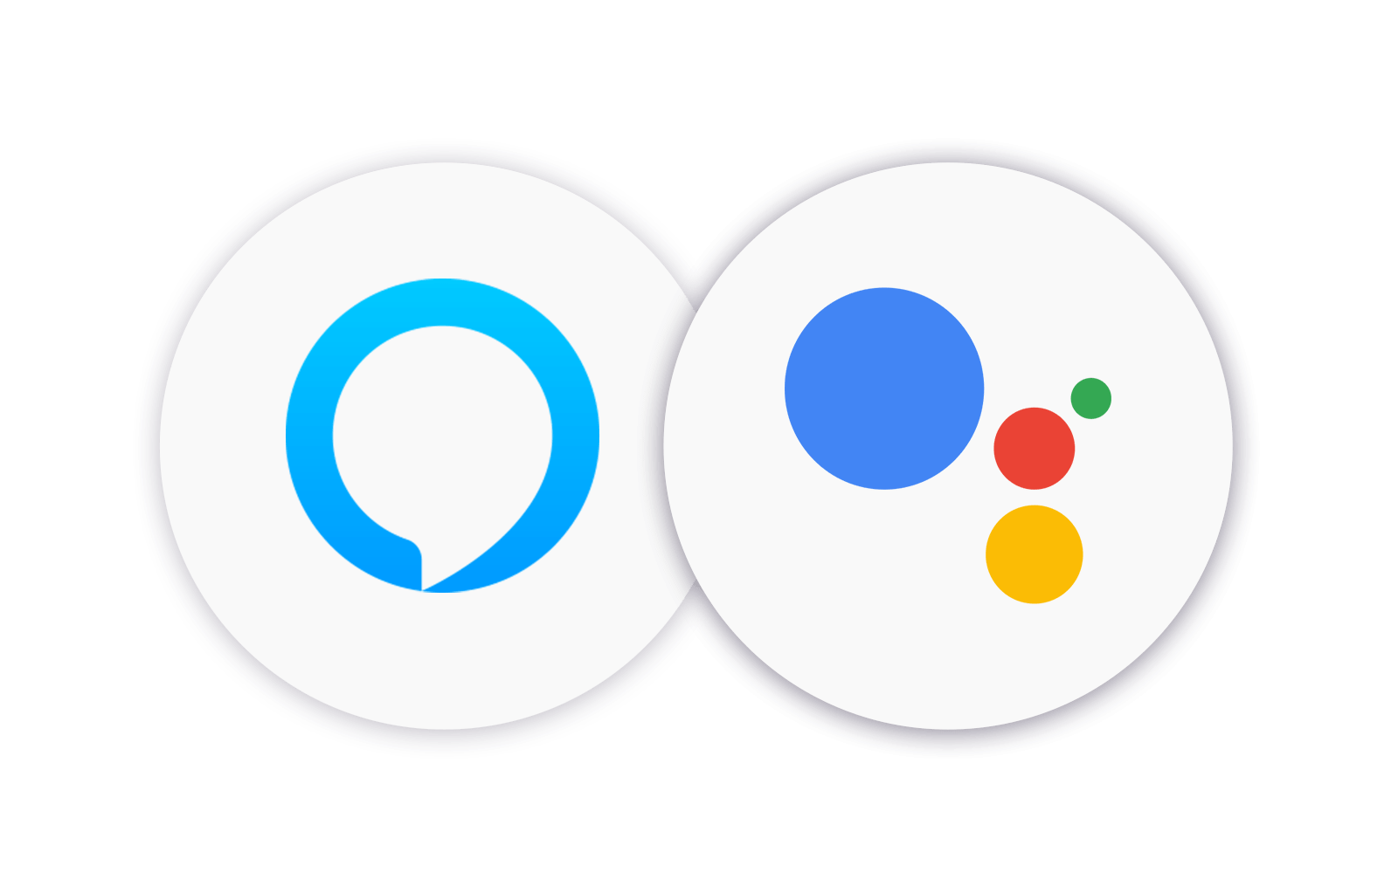

SOFTWARE DESCRIPTION
Arduino IDE (Integrated Development Environment) is an open-source software used for programming Arduino boards.
Sinric Cloud is a platform that enables the development of smart home applications, allowing users to control their smart devices.
Google Assistant and Alexa are popular voice assistants developed by Google and Amazon, respectively.

Slide 13


HARDWARE DESCRIPTION
Lora Module REYAX RYLR998 - 1
ESP8266 NodeMCU - 1
1k Resistors - 2
4.7k Resistor - 1
10k Resistor - 1
5-mm LED - 2
0.96" OLED Display - 1
Push button - 5
Lora Module REYAX RYLR998 - 1
Arduino UNO - 1
5v 4-channel Relay Module - 1
2k Resistor - 1
4.7k Resistor - 1
5-mm LED - 1
Push Buttons or Switch - 4

Slide 14
IMPLEMENTATION
Design of circuit for the implementation of the project.
Purchase of component required for the project.
LoRa module configuration.
LoRa range test.
LoRa AT command testing.
Node MCU Coding.
Cloud configuration and application building.

Slide 15
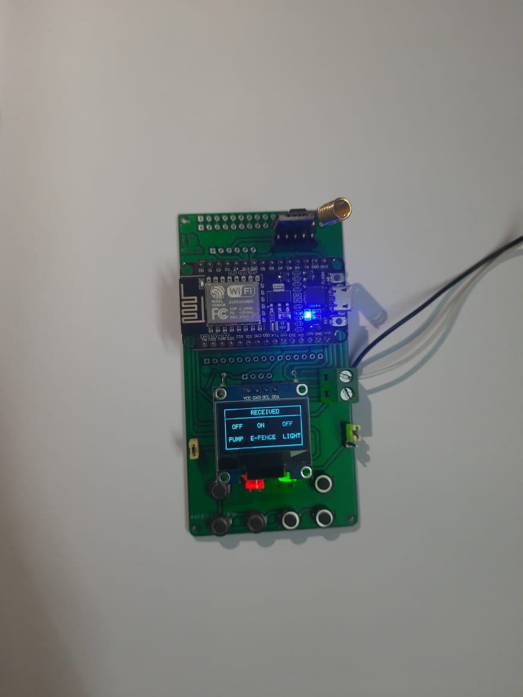
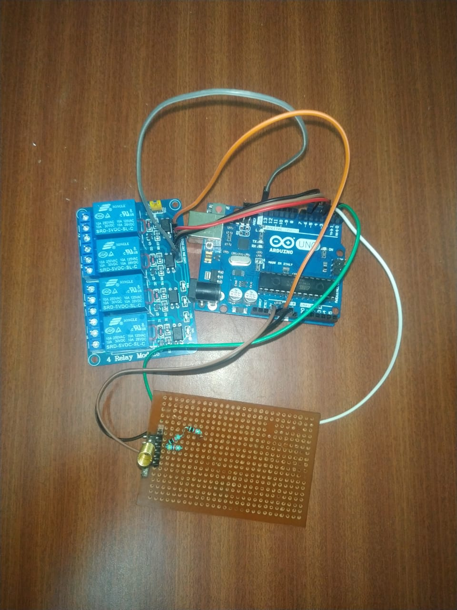
FINAL PROJECT SETUP

Slide 16
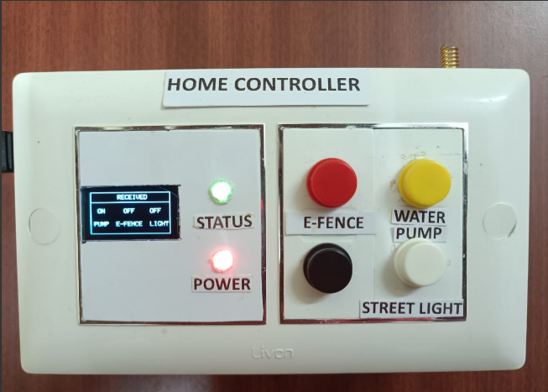
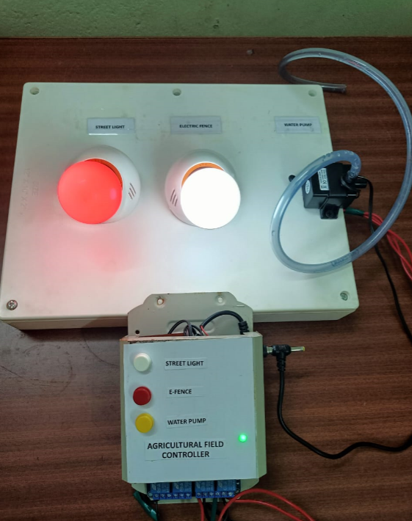
RESULT

Slide 17
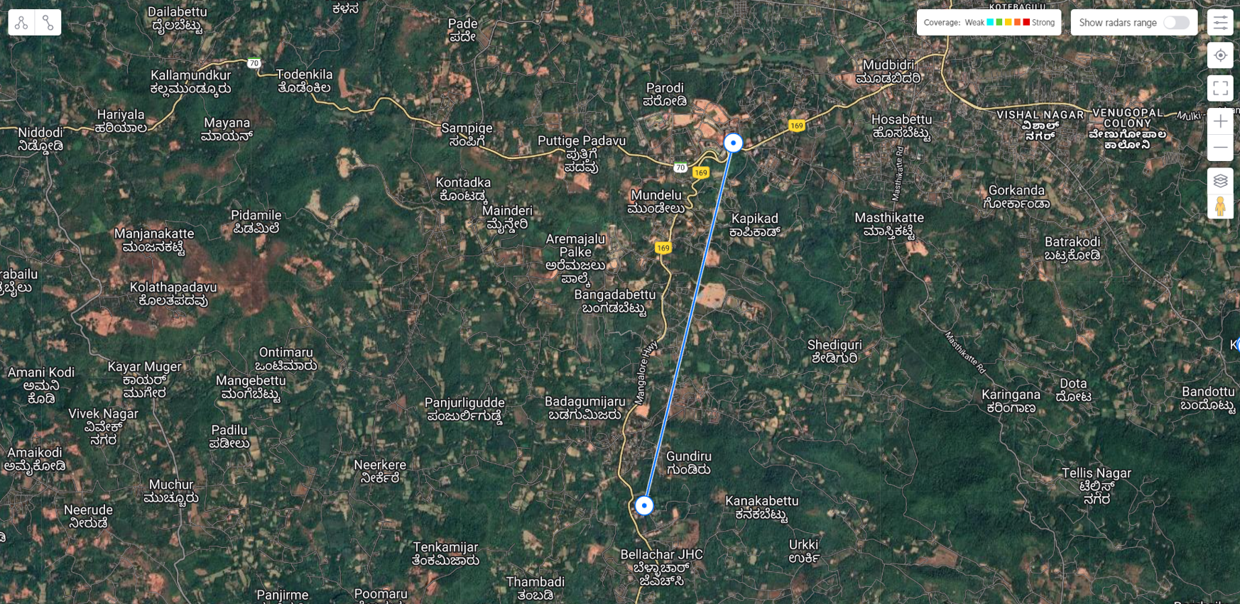
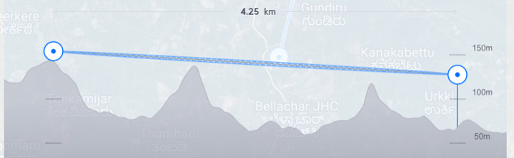
RANGE TEST RESULT

Slide 18
CONCLUTION
In conclusion, a LoRa and IoT-based smart irrigation system can offer many benefits for farmers and other stakeholders in the agriculture industry.
By using this model labour cost reduced, increases the crop yield, increase the efficiency, improves the plant health and improves the monitoring and controlling.
The benefits of long-range, low-power wireless communication make LoRa technology to use at many cases.

Slide 19
REFERENCES
Daveev, K. Mitreski, S. Trajkovic, V. Nikolovski and N. Koteli, “IoT agriculture system based on LoRa WAN," 2018 14th IEEE International Workshop on Factory Communication Systems (WFCS), Imperia, 2018.
C. Bouras, A. Gkamas, V. Kokkinos and N. Papachristos, "Using LoRa Technology for IoT Monitoring Systems," 2019 10th International Conference on Networks of the Future (NoF), Rome, Italy, 2019.
C. S. Gaddam and M K. Rai, "A Comparative Study on Various LPWAN and Cellular Communication Technologies for IoT Based Smart Applications," 2018 International Conference on Emerging Trends and Innovations In Engineering And Technological Research (ICETIETR), Ernakulam, 2018,
A. Lavric and V Popa, "Internet of Things and LoRa™ Low-Power Wide-Area Networks: A survey," 2017 International Symposium on Signals, Circuits and Systems (ISSCS), Iasi, 2017

Slide 20
THANK YOU

